Slide 1
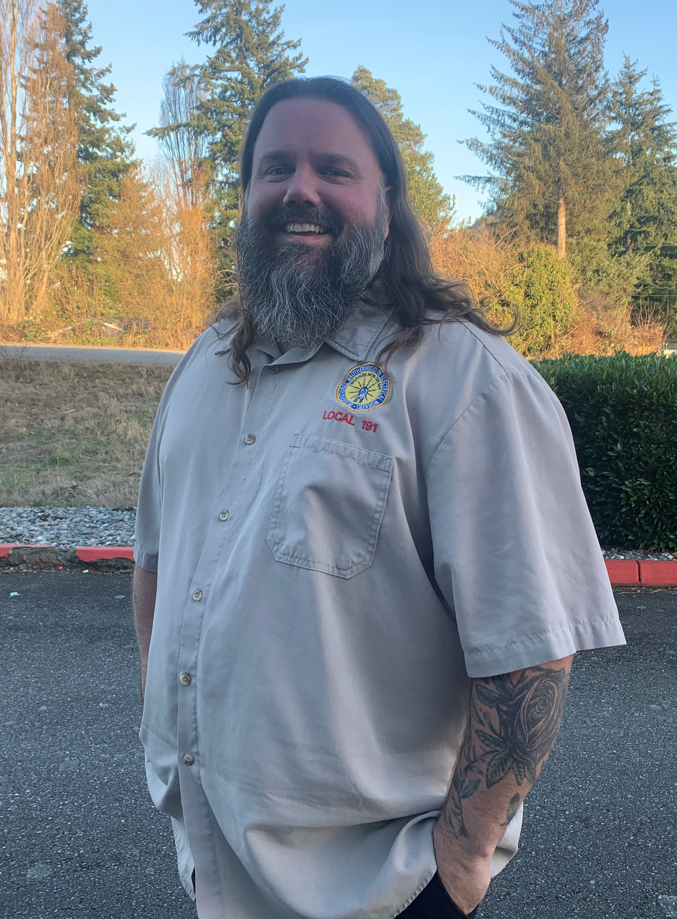
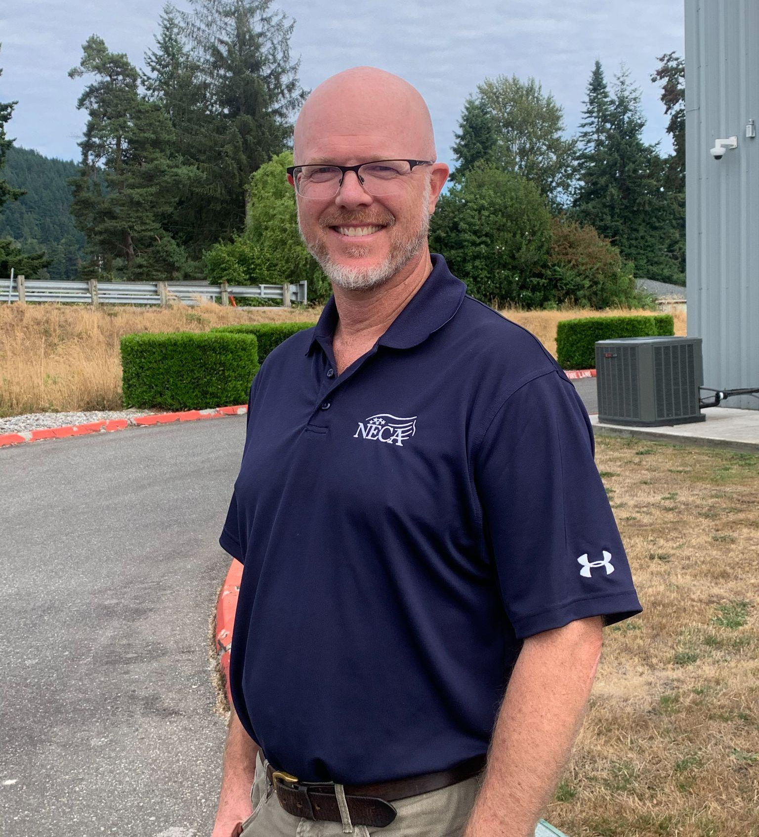
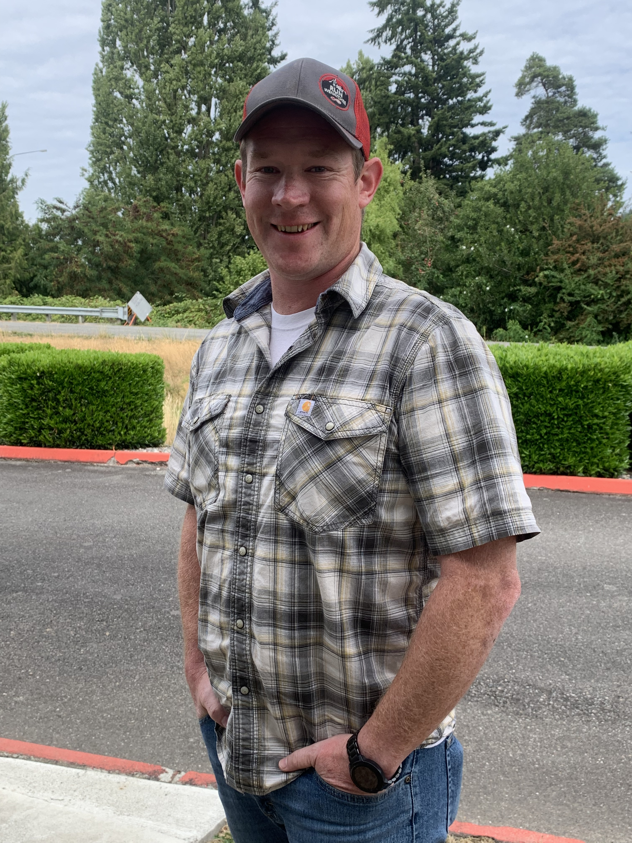
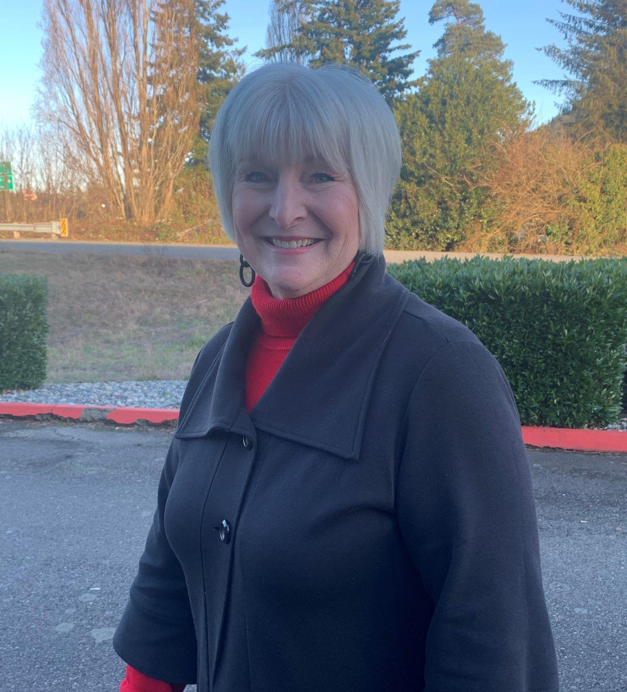
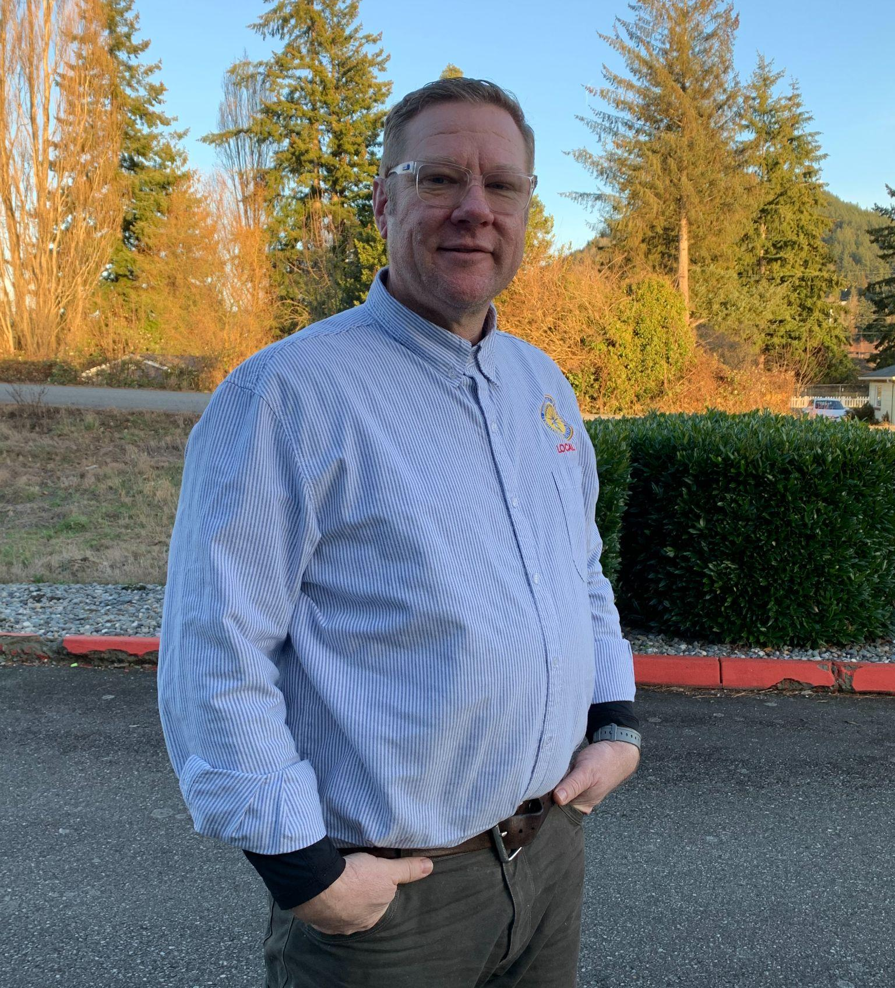
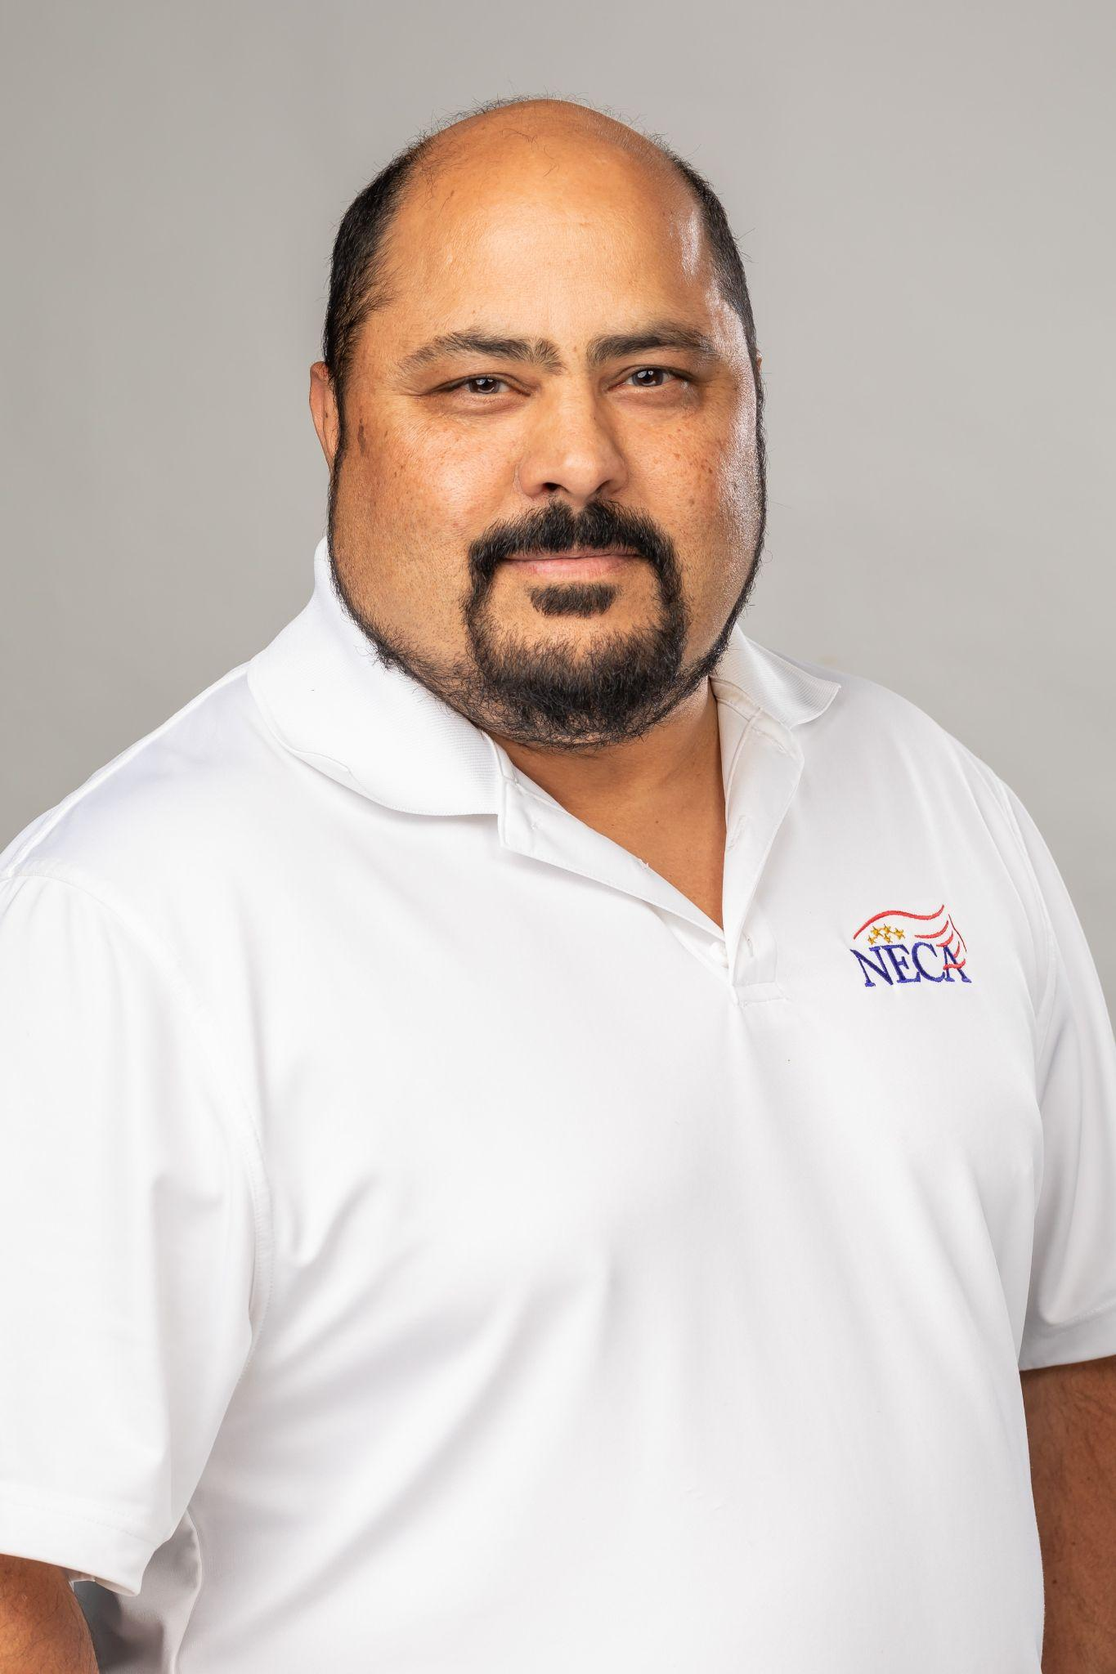
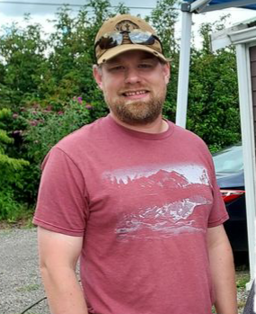
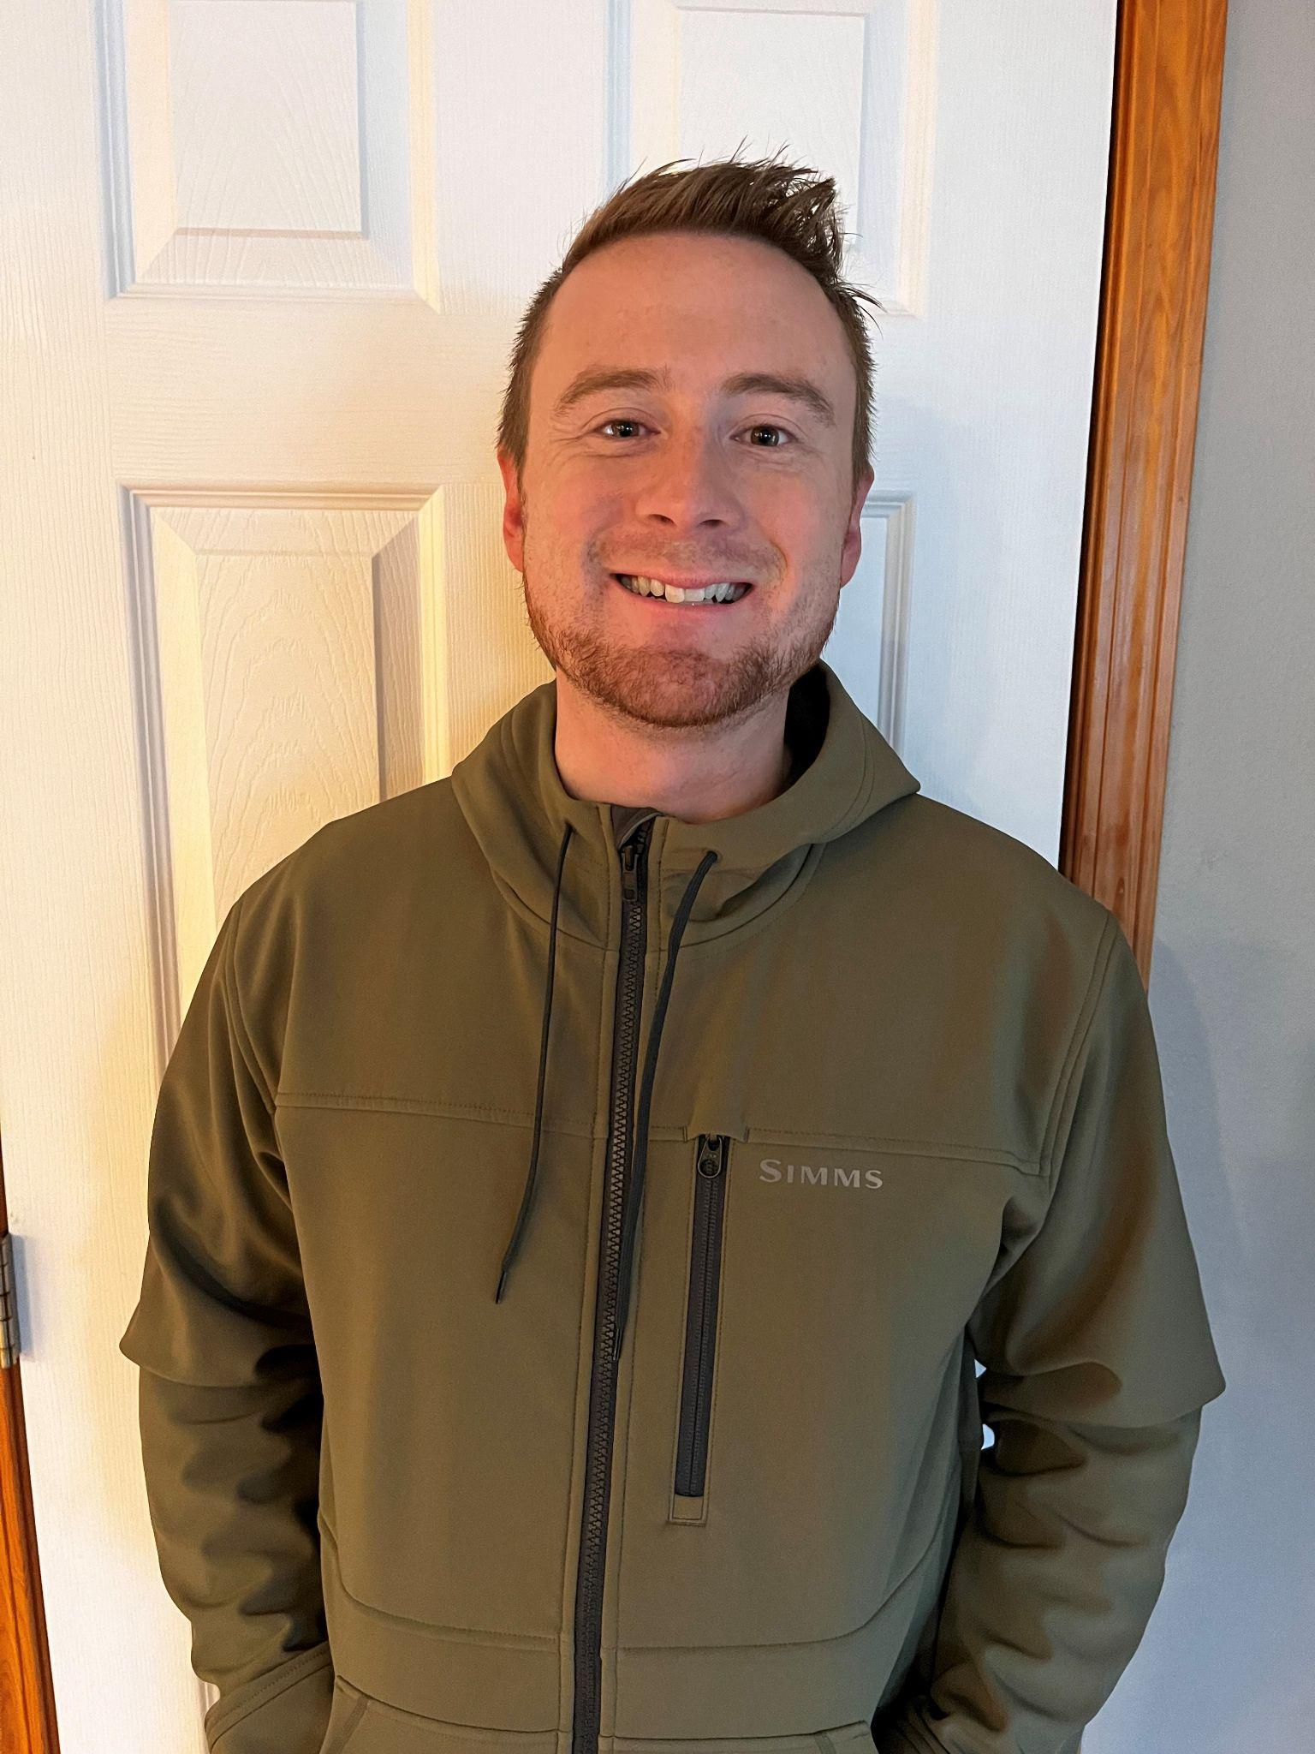
NWEJATC Committee Members/Trustees
LABOR
MANAGEMENT
NWEJATC Committee Members/Trustees
Randy Curry, Secretary | Erik Sorenson, Chairman
Craig Jones | Cindy Austin
Barney | Bruno Padilla
Derek Stuurmans | Steve Ferris
Randy Curry, Secretary
Erik Sorenson, Chairman
Jeremy Chase
Cindy Austin
Barney Smith
Bruno Padilla
Derek Stuurmans
Steve Ferris

